Slide 1

TNO: Applied scientific research

Slide 2
BIMserver.org “project”:
BIMserver.org mission is to help all actors in the Architectural, Engineering and Construction (AEC) industry to collaborate more efficiently and effectively (and thereby creating better buildings for lower costs).
BIMserver.org goal is to create the most favorite software platform for collaboration in the AEC-industry.
http://bimserver.org/about/philosophy/

Slide 3
What it is?
Software
That you can download and install to turn your computer into a ‘bimserver’

Slide 4
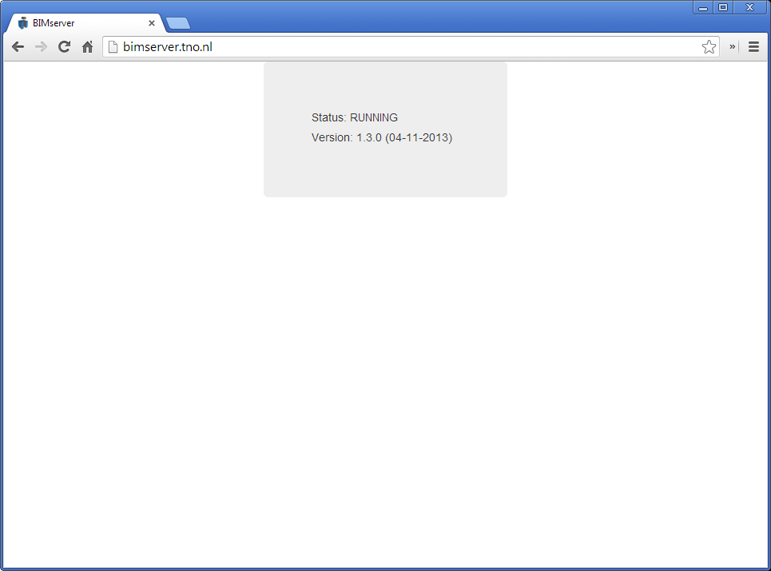
How it looks….

Slide 5
BIMserver Strategy:
Mission: help AEC to collaborate more efficiently and effectively
+
Position: researchers = not software vendors
Creating a platform for others to build on top / extend;
No direct end-users;
Creating a snowball effect;
=
Goal: create most favorite platform by lowering the threshold for developers of niche applications
=
Mission: help AEC to collaborate more efficiently and effectively

Slide 6
The plugin framework (example for ‘output’)
GUI plugins
Remote Services
Internal ‘apps’
Serializers
EMF
core
Object
IDMs
Database(s)
ServiceInterfaces
(SOAP, PB, JSON)
Including BIMSie standard
Merge
algorithms
Render engines
Query engines
Compare algorithms
Model-checkers

Slide 7
What BIMserver is….
Open and stable core to use and build on top
Core server features like revisions, authorization, compare, query, modelchecking, merging, etc..
Open interfaces, lots of network protocols (soap, PB, json)
Open standards
Plugin framework for render engines (like IfcOpenShell); ObjectIDMs & Query engines (like BimQL)
Flexible admin configuration & fine-tuning
Good developers documentation and SDK
Open source
Etc..

Slide 8
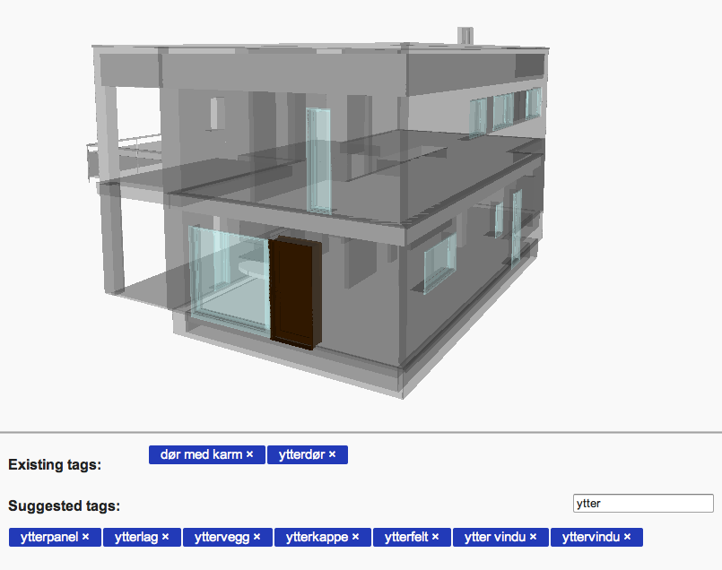
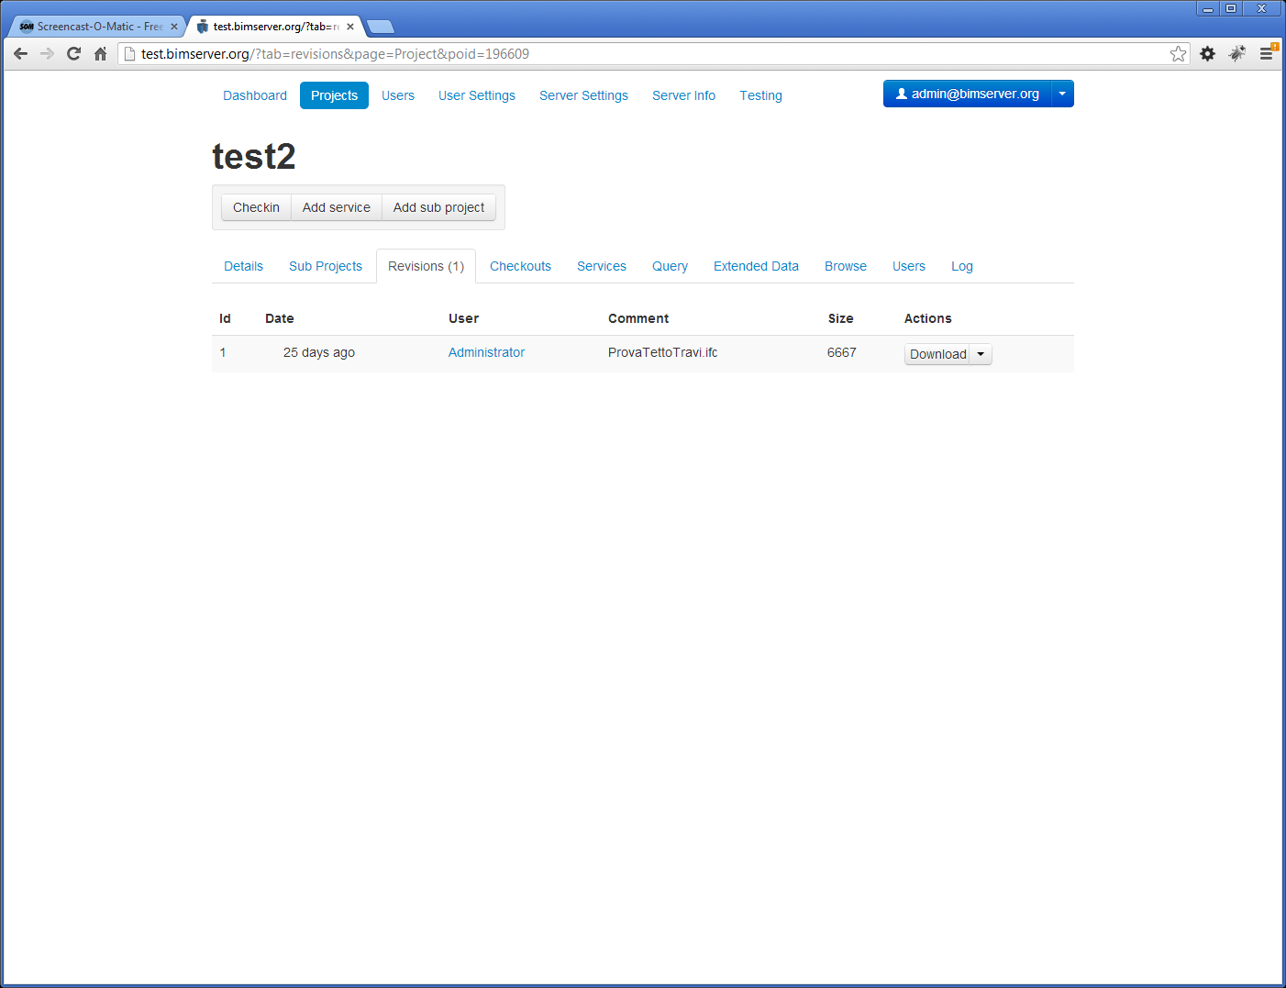
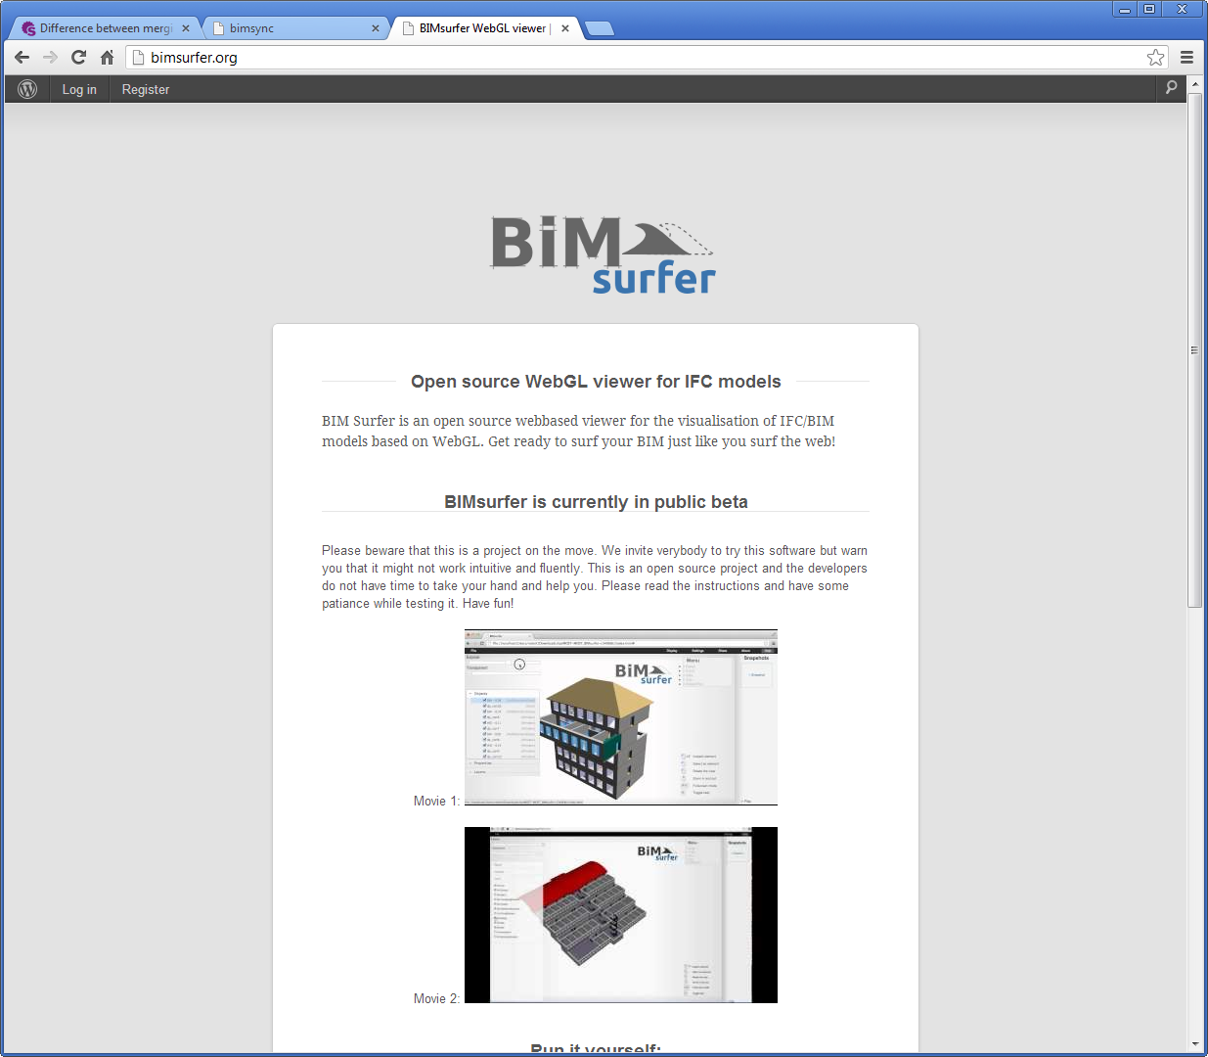
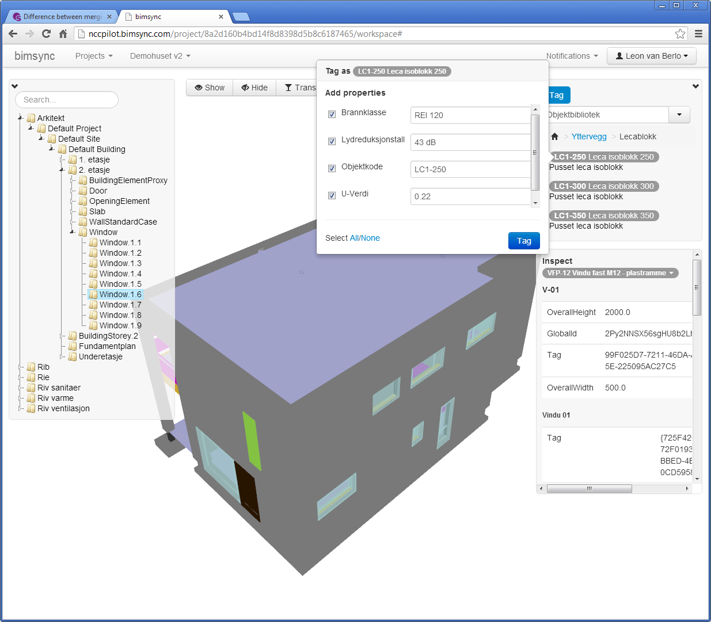
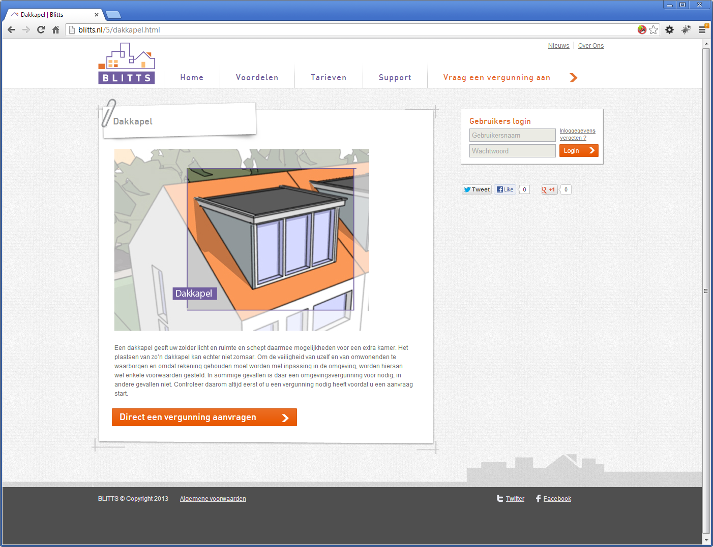
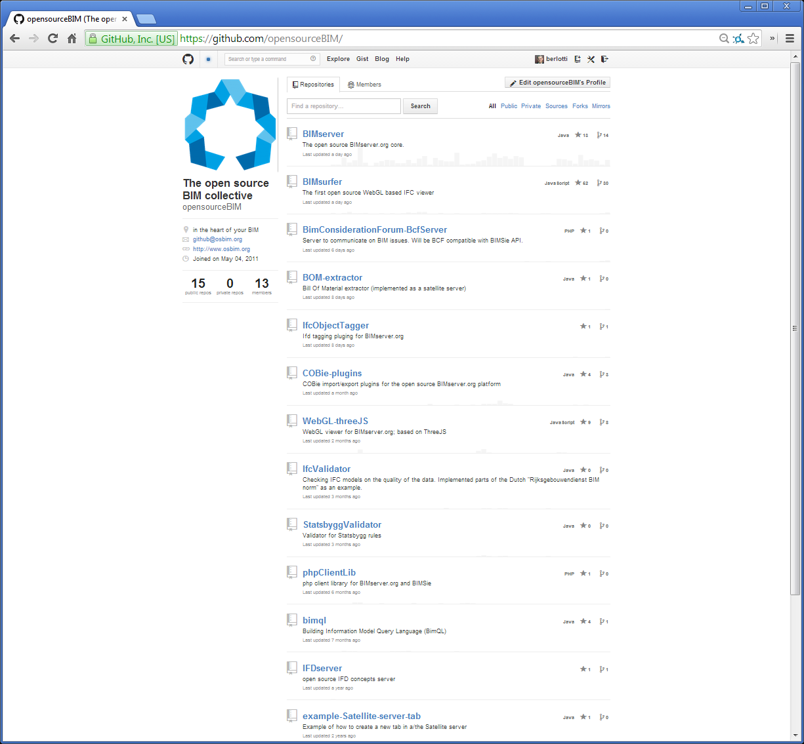
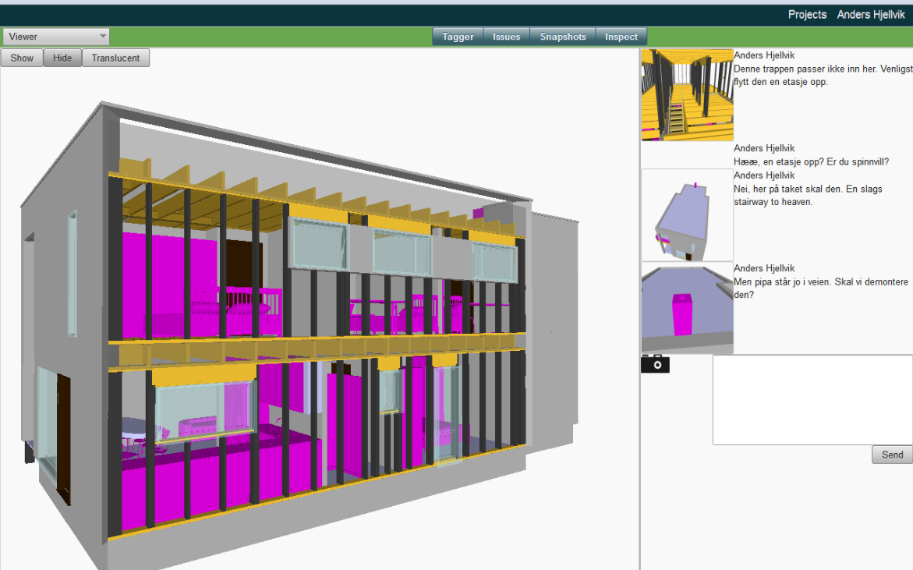
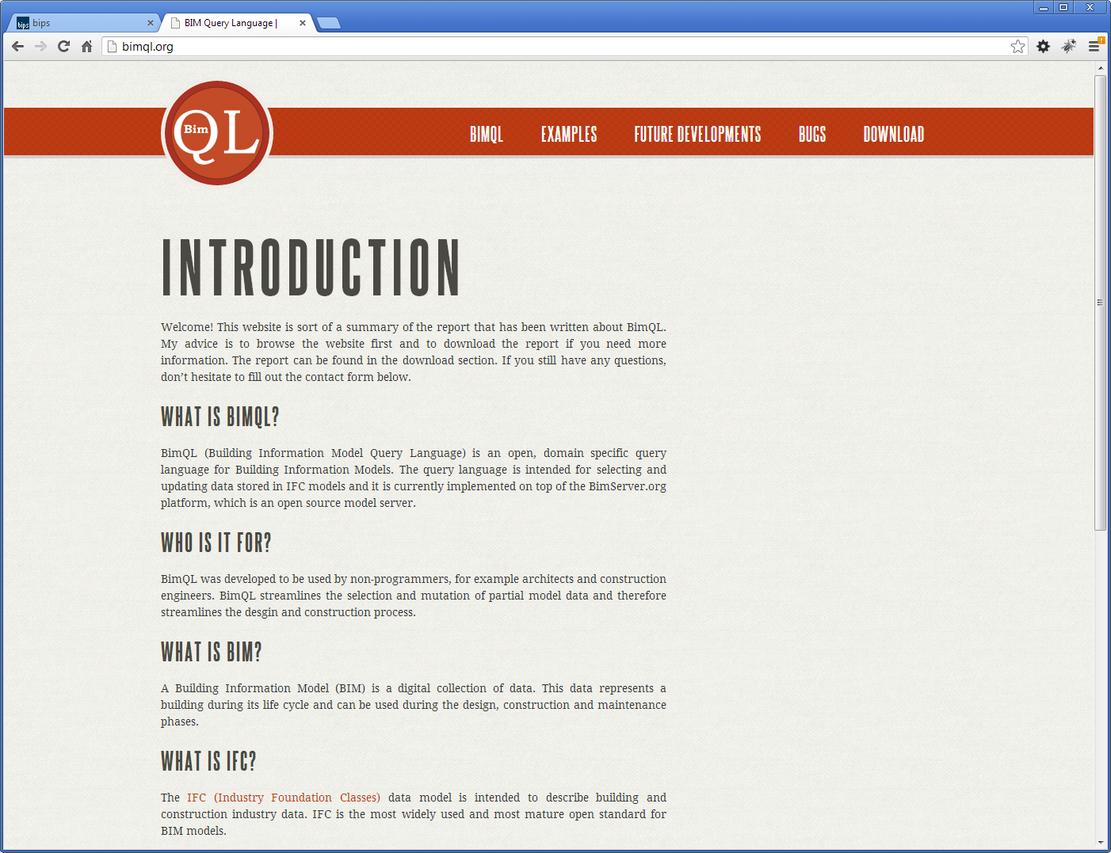
What people are building…..

Slide 9

Most of it we don’t know…

Slide 10
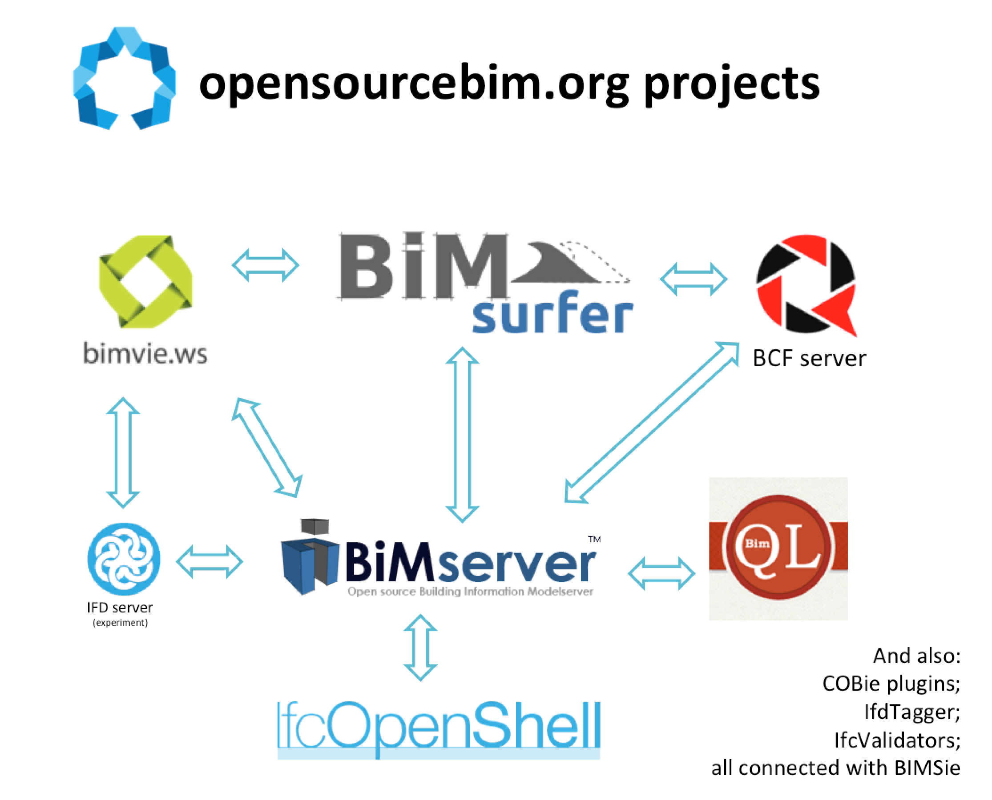
Part of a bigger picture

Slide 11
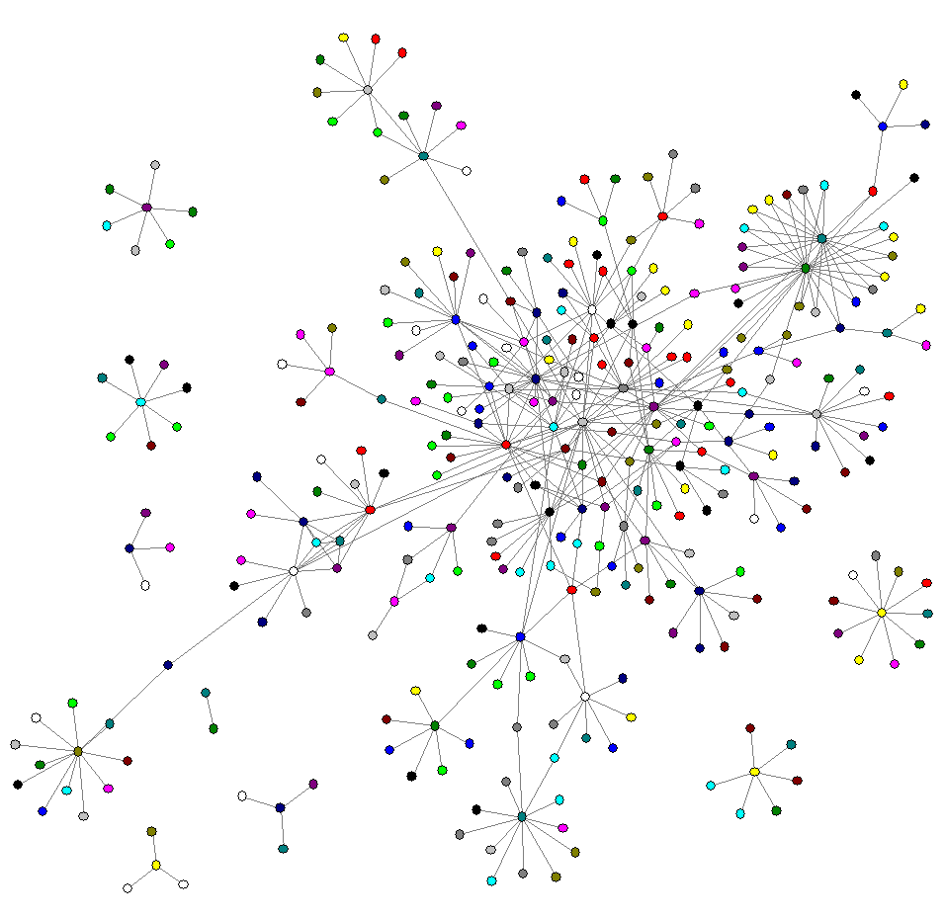
There is NO central BIM!

Slide 12
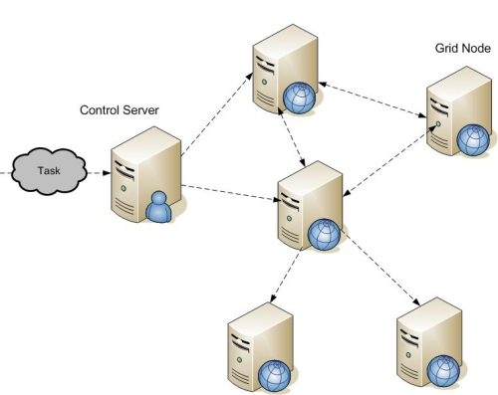

Slide 13
Staircase automodeller
Clashdetectionservice
BIMserver
Validationchecker
CO2 lifecycle calculation
Viewer

Slide 14
An example

Slide 15
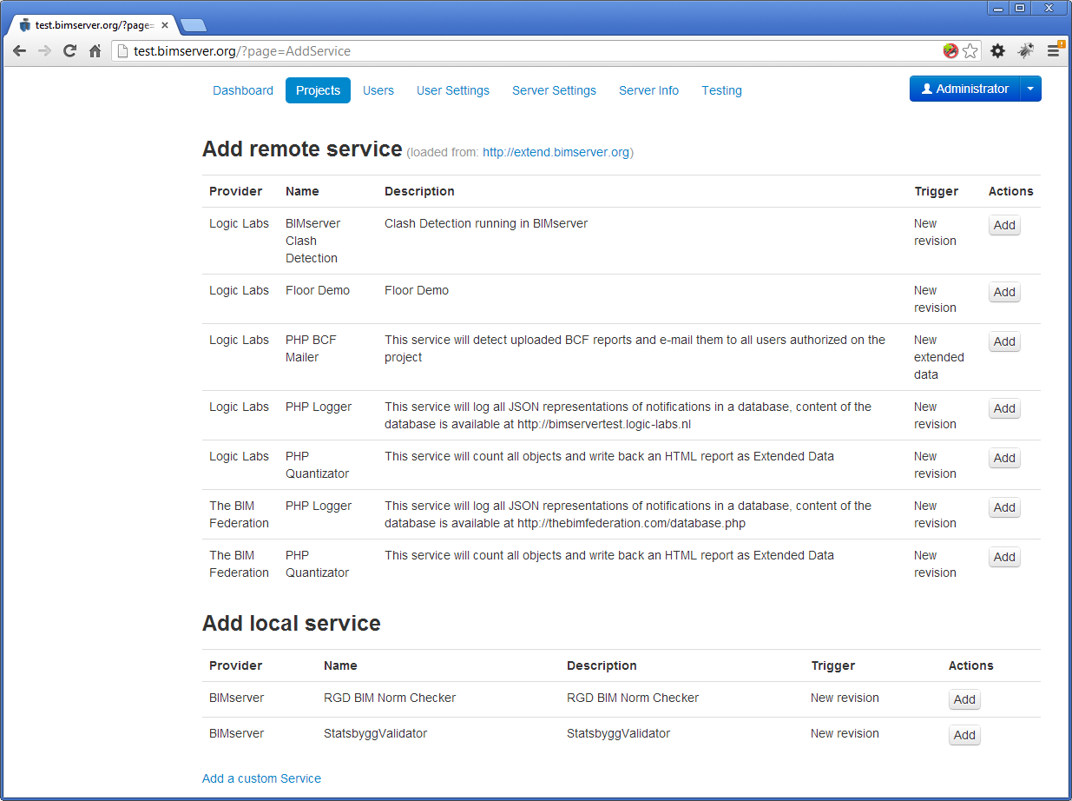

Slide 16
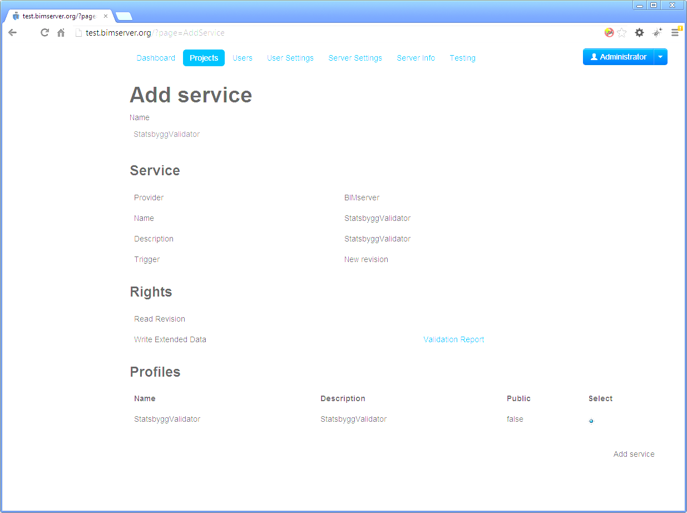
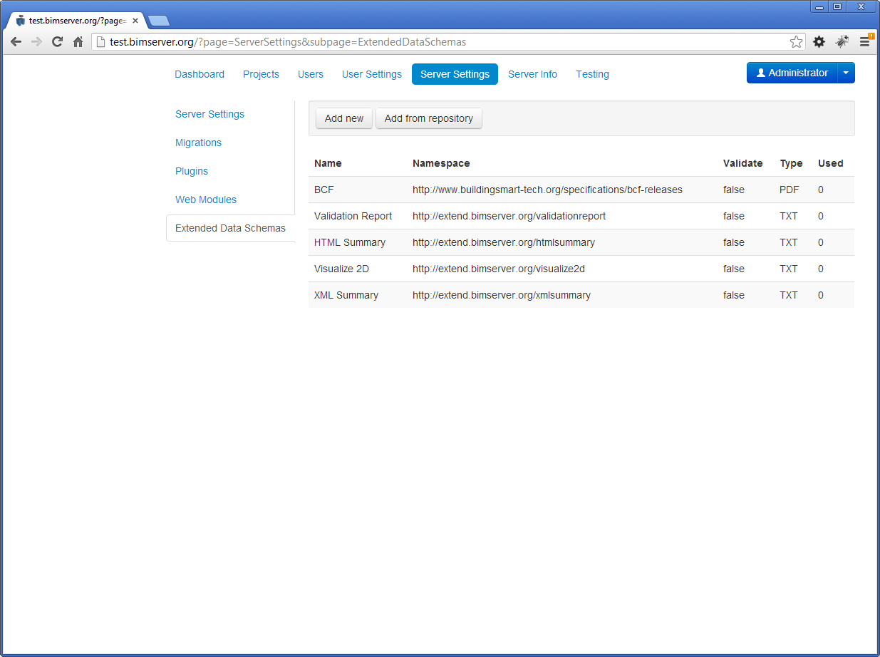
Modelchecking

Slide 17
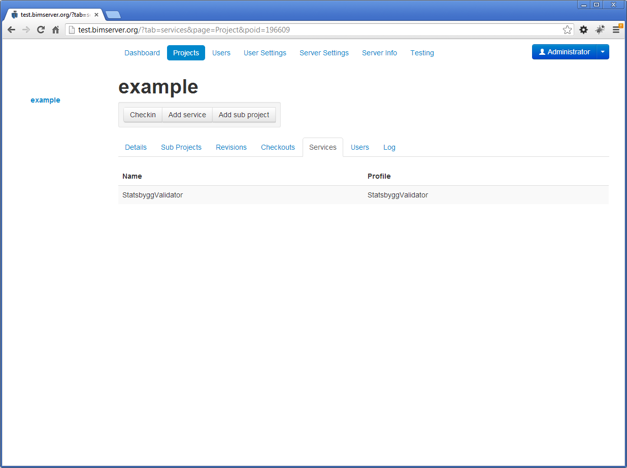

Slide 18
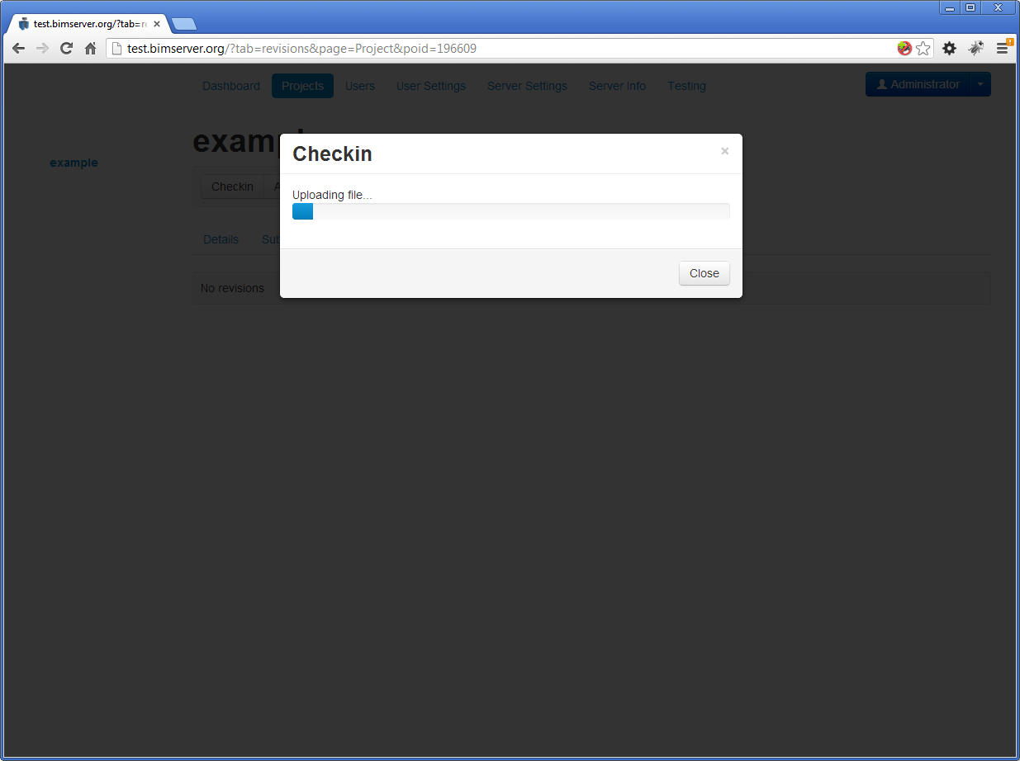

Slide 19
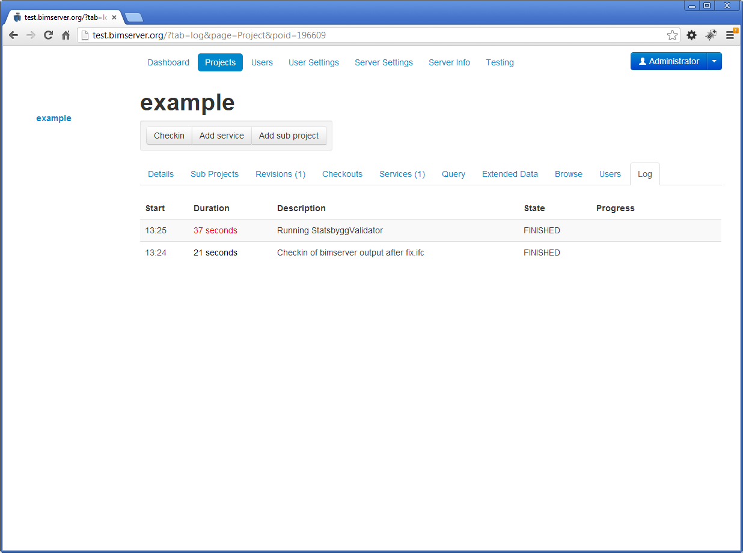

Slide 20
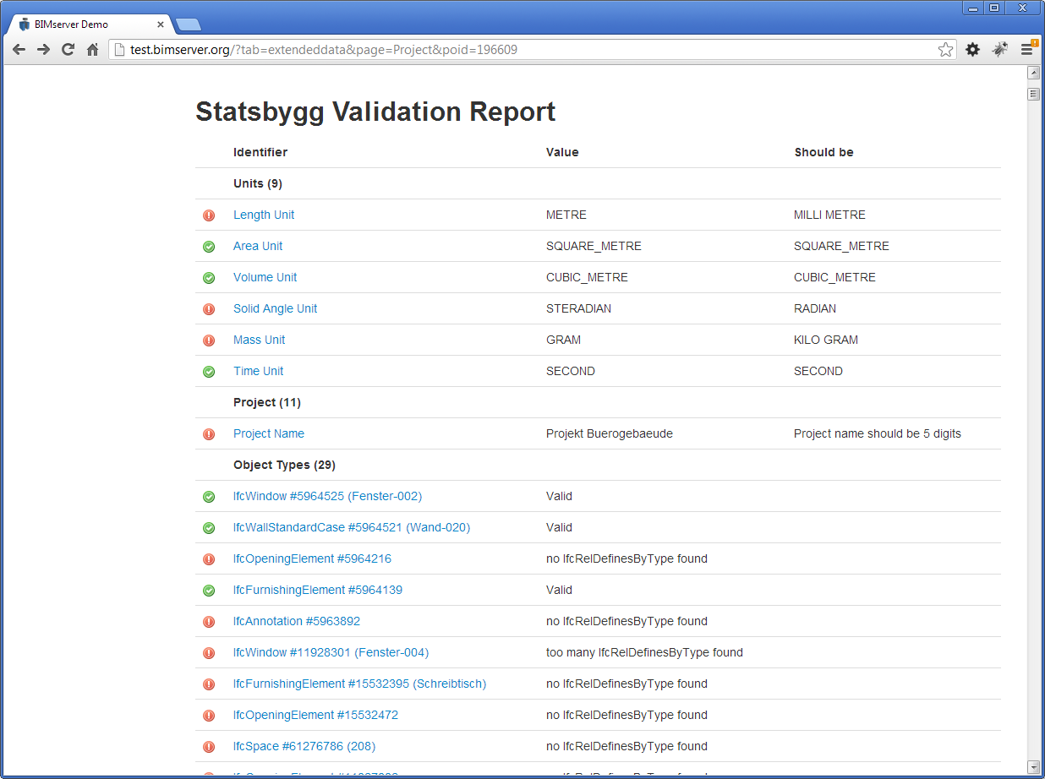

Slide 21
What happenend?
User: checkin model (IFC)
GUI: communicating with server
Server: modelcheck if data is according to ruleset
Server: sending notification to subscribed service about new revision
Remote Service: getting model (with token) from server *
Remote Service: analysing model *
Remote Service: sending JSON report back to server *
Server: checking if JSON file is valid and autorised to recieve
Server: adding JSON file to ‘extended data’ in revision
GUI: viewing JSON file with special viewer based on schema
* = constant interaction between service/server/gui about status

Slide 22
The big(ger) picture

Slide 23




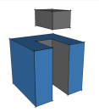

The big picture
User
BIM Service
GUI
BIM Service
Dataserver
BIM Service
User
GUI
IFC Dataserver
sandbox.bimserver.org
Amsterdam, NL
Dataserver
Dataserver

Slide 24
The bigger picture: Everything is a “BIM Service”
User
User

Slide 25
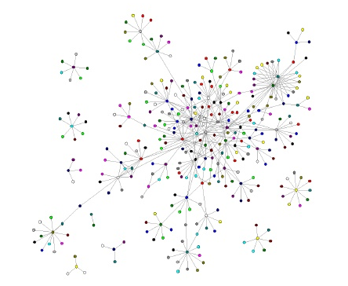
Niche applications
‘remote’ services like:
Bimserver (“BIM Data service”)
Clashdetection
CO2 life cycle calculation
Floorplan generator
Supplier automators (staircase, floors,etc)
Android app
Loggers and analyses
Validation checkers
BOM extractor
Furniture placer
SpaceInvaders app
PNG renderer
2D Floorplan generator
….
Everything automatic and ‘on demand’ event driven

Slide 26
Current (old) demonstrator
1. Checkin model (bimserver)
- Staircase supplier sends staircase model (IFC)
- Floorsupplier(IFC)
- Innerwall supplier (IFC)
2. Clashdetection (BCF)
3. Check on IFC quality (Statsbygg / RGD)
4. CO2 life cycle analyses (PDF)
2. Sync with datastore of projectmembers
4. Client gets COBie model update for FM in dropbox

Slide 27
Remote services
Can be closed source / ask money for specific features (profiles)
Based on publish/subscribe principle (subscription to events)
Can be more than one per topic (competition)
Is centralized for the service provider
This:
Creates a new market for niche appliations
Gets BIM into the web
Takes advantage of the fragmented nature of the industry
Is an open approach instead of getting everything on one black box: crucial is to standardize the API between services

Slide 28
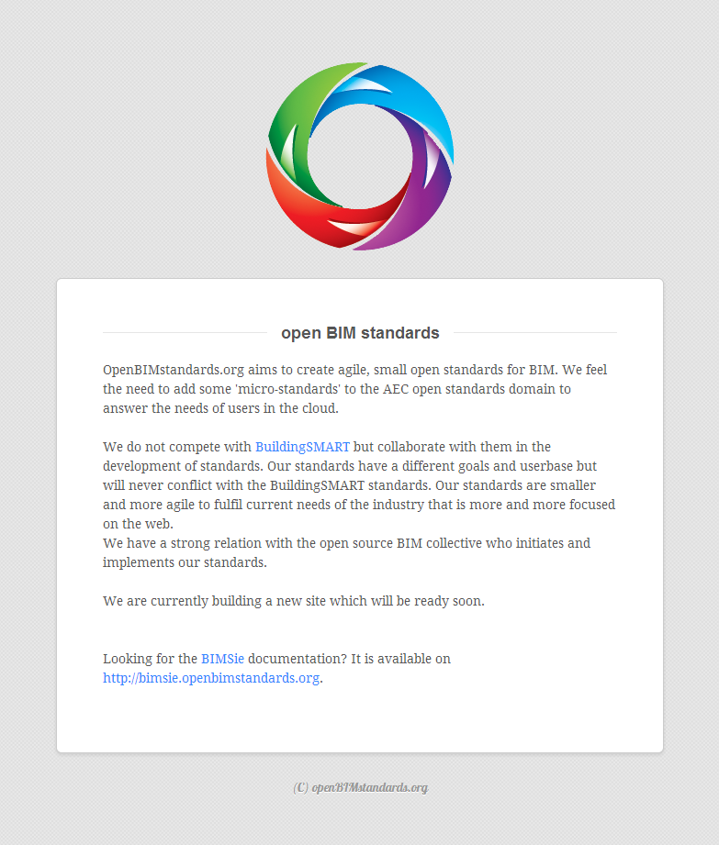

Slide 29
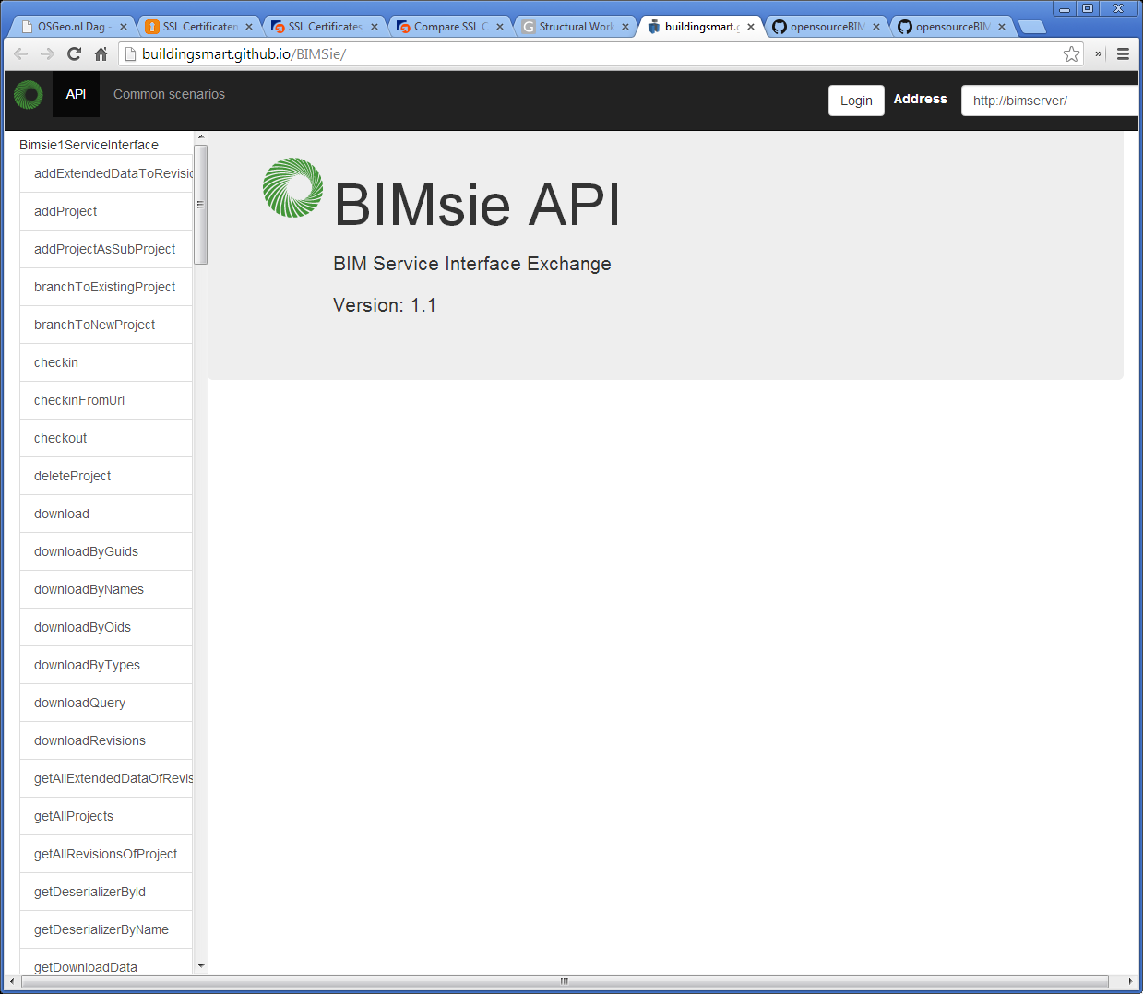
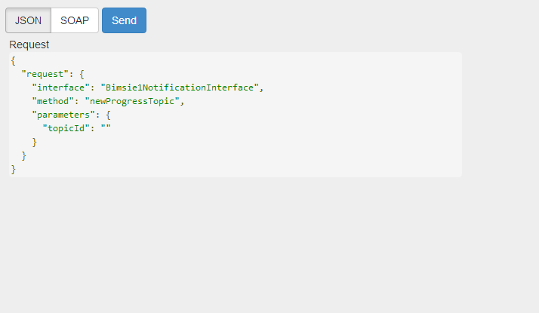

Slide 30
Questions? Leon.vanBerlo@tno.nl @berlotti +31 6 423 674 65 www.bimserver.org bimsie.openbimstandards.org

